Slide 1
OBESITY PREDICTION

Slide 2
Outline of The Presentation
Problem Statement
Technology Adopted
Data Set Details
Methodology
Results and Findings
Conclusion

Slide 3
Problem Statement
Obesity is a major public health issue that affects millions of people worldwide and contributes to several
Chronic diseases such as diabetes, cardiovascular disease, and hypertension. Early I dentification of individuals
at risk of obesity can help in timely intervention and better healthcare planning.
This project aims to develop a machine learning classification model that can analyze lifestyle-related features
such as food consumption habits, physical activity levels, family history, and water intake — to predicts the
obesity level of a person.

Slide 4
Technology Adopted
Python – Main programming language used for data analysis, preprocessing, visualization, and model building.
Pandas – Used for loading and handling the dataset, data cleaning, and manipulation.
NumPy – (implicitly used by Pandas and Scikit-learn) for numerical operations.
Seaborn & Matplotlib – Used for data visualization like box plots, histograms, scatter plots, count plots, and
heatmaps.
Scikit-learn (sklearn) –For splitting the data,Standardizing features ,Building the logistic regression model and
Evaluating model performance
Jupyter Notebook / Google Colab – IDEs or environments used to run and visualize the code interactively.

Slide 5
Data Set Details
The dataset contains 2,111 records from people in Mexico, Peru, and Colombia.
It includes both real and synthetic data about lifestyle habits and physical conditions.
The goal is to predict obesity levels based on personal and health-related features.
There are 16 input features like age, gender, height, weight, food habits, physical activity, and water intake.

Slide 6
.
Methodology
Loaded and cleaned the dataset
Removed duplicates and dropped unnecessary columns
Converted categorical data to numeric format
Split data into training and test sets
Scaled the features using StandardScaler
Applied Logistic Regression model
Evaluated the model using accuracy, classification report, and confusion matrix
Visualized data and results using seaborn and matplotlib

Slide 7
Result and Findings
Dataset has 2111 records with 16 lifestyle and health features.
Data cleaned by removing duplicates and dropping less useful columns.
Categorical values converted to numerical format.
Visualizations showed patterns in gender, weight, age, and obesity levels.
Physical activity and family history strongly linked to obesity.
Logistic Regression model used for prediction.
Data split into training and testing sets (70/30).
Model evaluated using accuracy, classification report, and confusion matrix.
Results showed good prediction of obesity levels from lifestyle factors.

Slide 8
Conclusion
Categorical data was converted into numerical format for analysis
Data visualization showed trends based on gender, age, weight, activity, and eating habits
People with poor eating habits and low physical activity had higher obesity levels
Logistic Regression was used to build the prediction model
The model was trained using scaled data for better performance
Model performance was evaluated using accuracy, classification report, and confusion matrix
The model gave a good accuracy in predicting obesity levels
Lifestyle factors play a big role in obesity, and machine learning helps in early detection

Slide 9
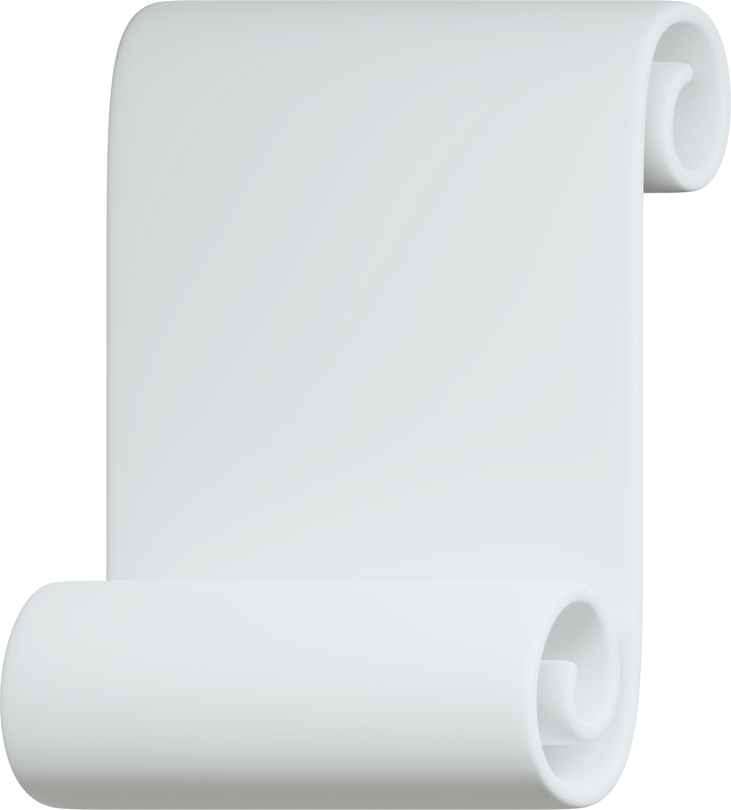
THANK YOU

